Slide 1

New ways to read
‘Language on a holiday’
Machine learning applied to philosophical texts
Joshua Banks Mailman
jmailman@alumni.uchicago.edu

Slide 2



Applications
Recommender systems
Automated text-to-speech
Education

Slide 3
Focus: Distinguishing text that has:
• Topical consistency
•Self-containment (self-explanatory)
• Verbal-semantic eccentricity (idiosyncrasy)

Slide 4
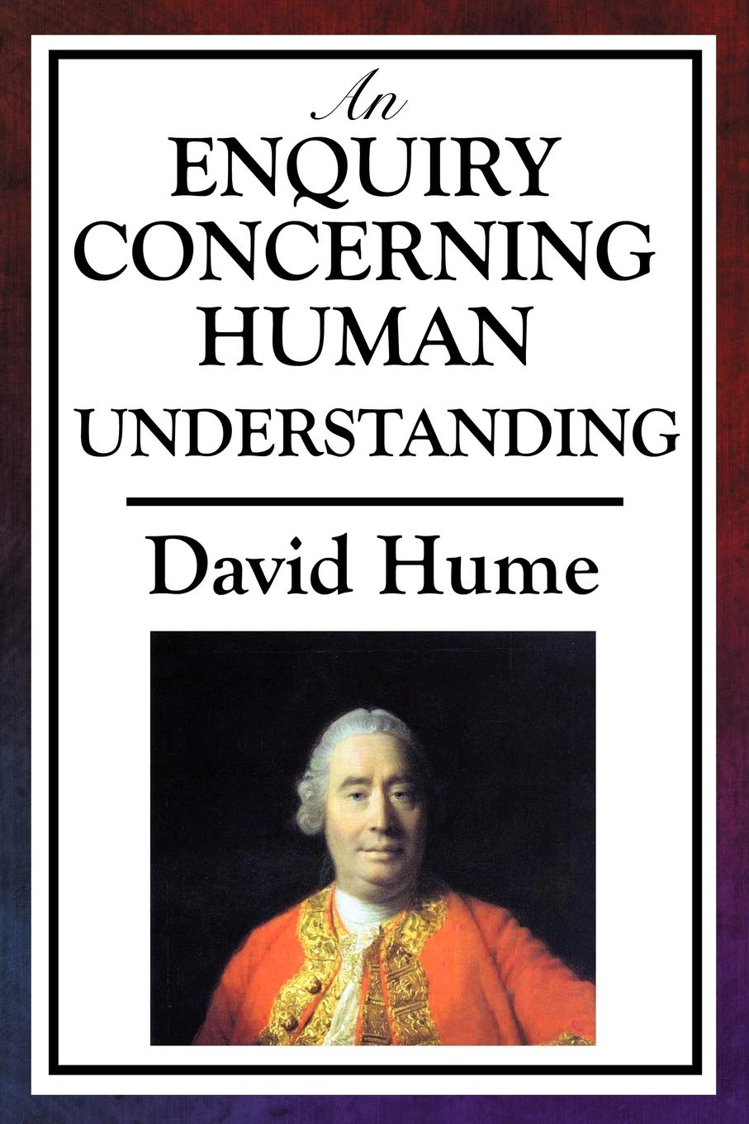
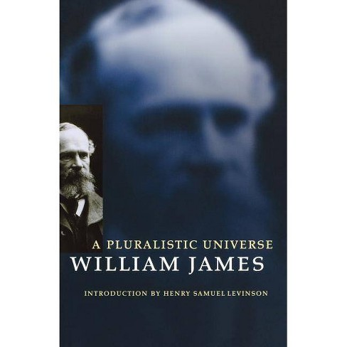
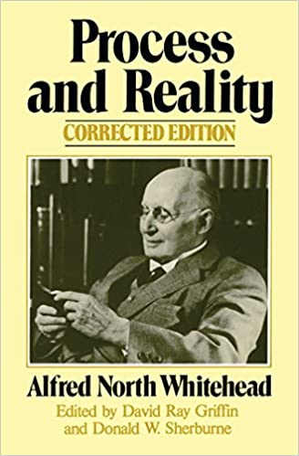
1748
1909
1928

Slide 5
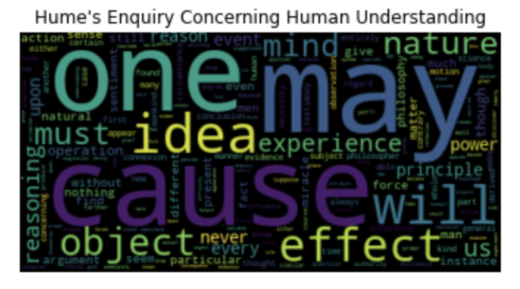
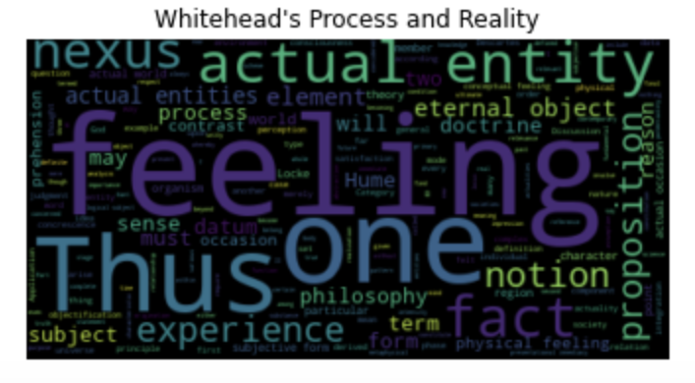
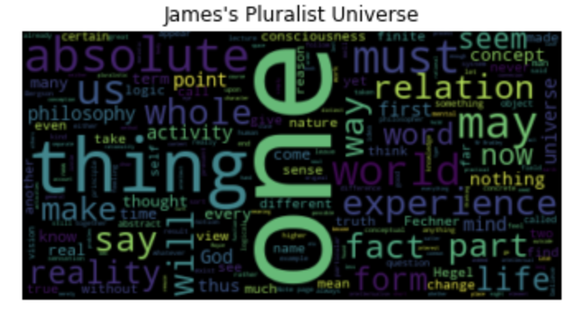
Hume was one of the earliest to draw attention to the distinction: correlation vs. causation, and issues of observing cause and effect.
Hume is known as among the most lucid philosophers.
Whitehead, by contrast, is infamous for the obscurity of his ideas and the idiosynracy of his verbal expression.
French philosopher Gilles Deleuze’s interest in Whitehead has brought more attention to his work recently.

Slide 6
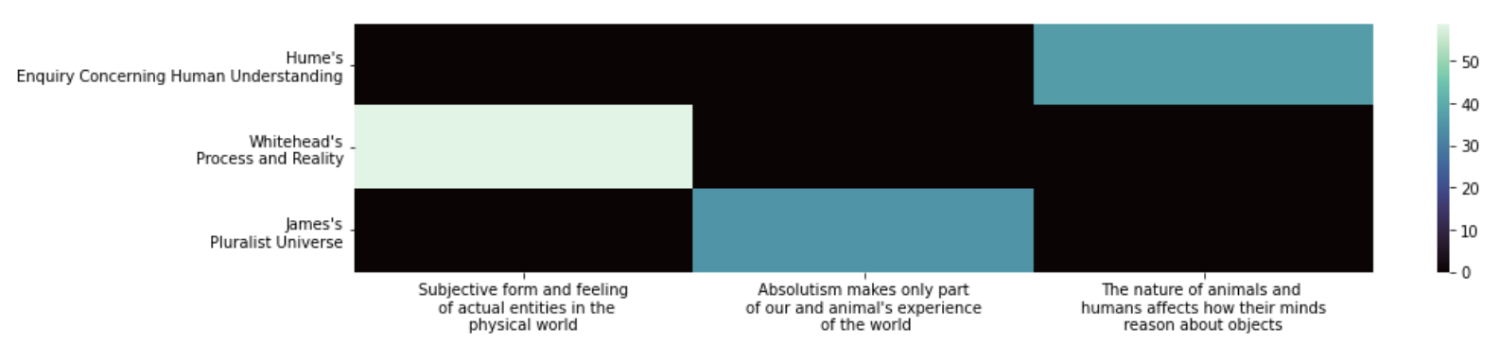
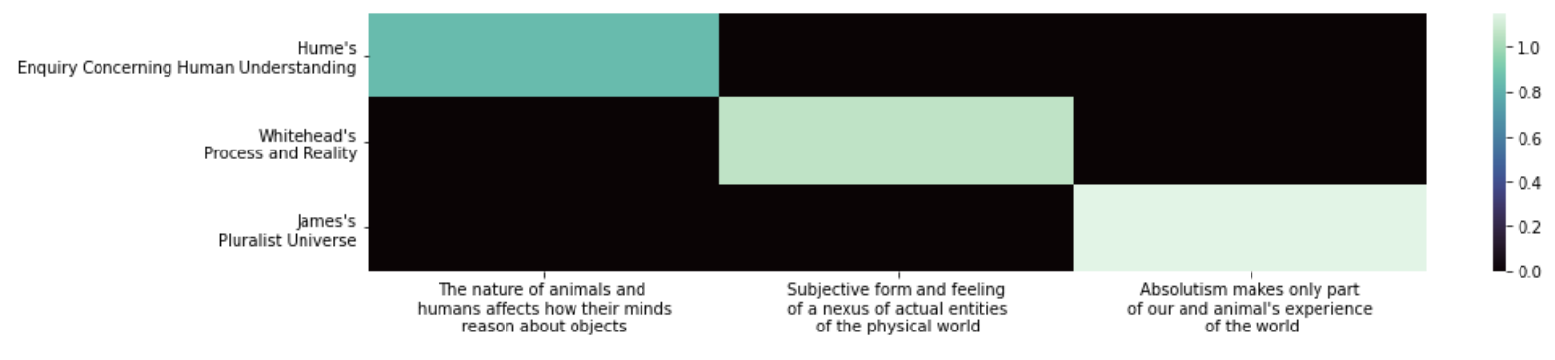
Topic modeling
NMF (non-negative matrix factorization)
snowball stemmer
Sentences composed (using domain knowledge) to use the primary words of each topic
word stemmer

Slide 7
Compare philosophical writing styles
The flow of prose
Topics from one paragraph to the next

Slide 8
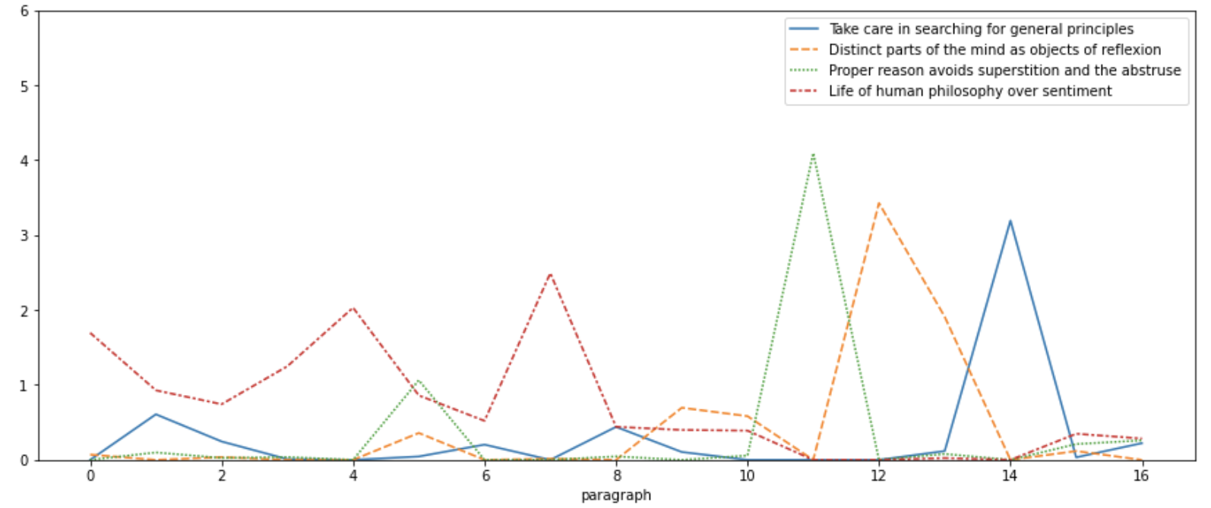
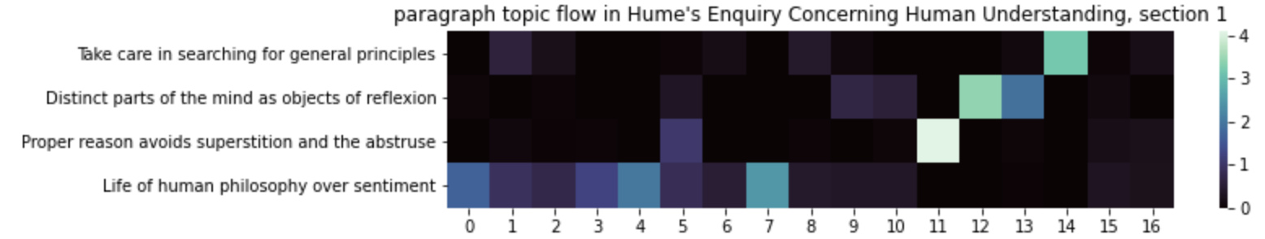
Hume
Paragraph topic flow (four topics)
Begins by maintaining a consistent topic

Slide 9
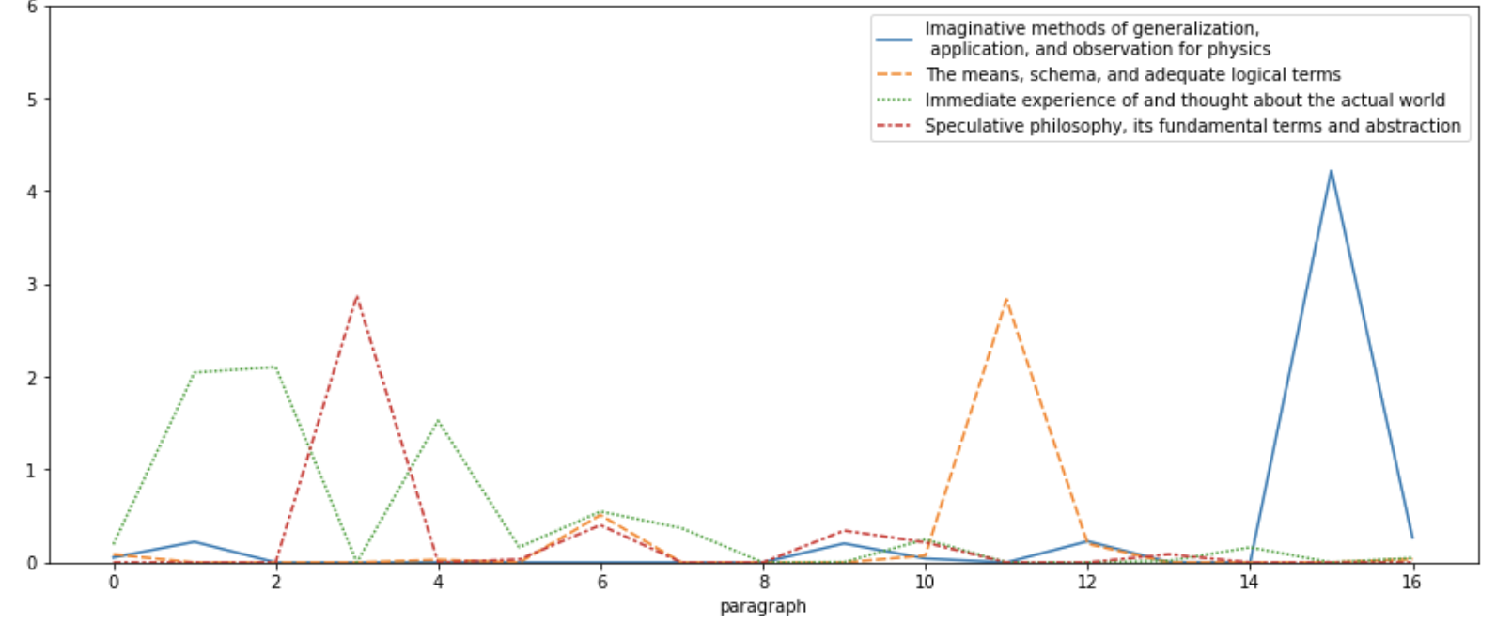
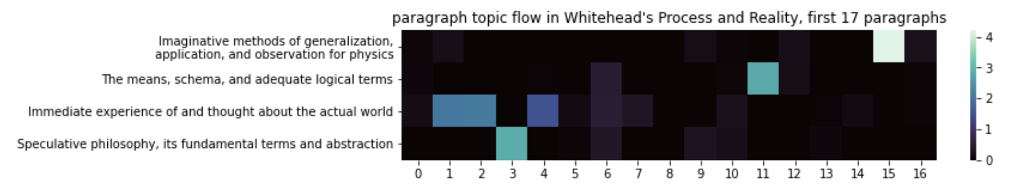
Whitehead
Paragraph topic flow (four topics)
Various topics
surging and
receding

Slide 10
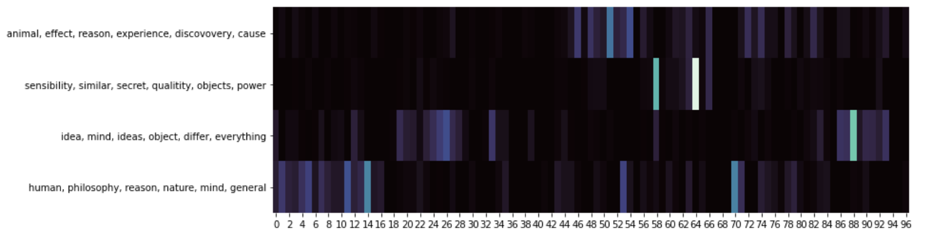
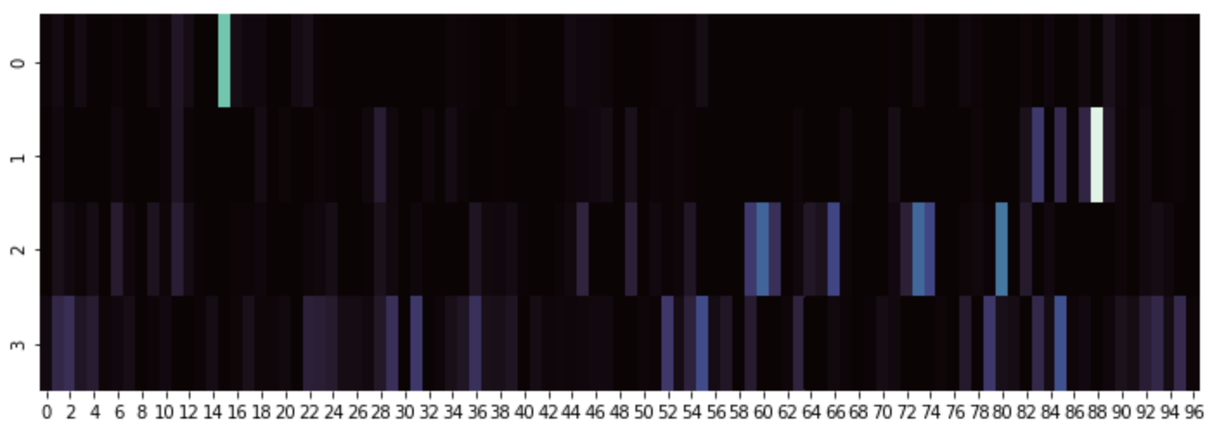
Paragraph topic flow
in longer passages
Hume (first 96 paragraphs)
Four topics
paragraph
Whitehead’s first chapter (96 paragraphs)
Four topics
paragraph

Slide 11
Whitehead
Paragraph topic flow (four topics)
a more free-standing self-explanatory passage
Larger generalities. In natural science this rigid method is the Baconian
method of induction, a method which, if consistently pursued, would have
left science where it found it. What Bacon omitted was the play of a
free imagination, controlled by the requirements of coherence and logic.
The true method of discovery is like the flight of an aeroplane. It starts
from the ground of particular observation; it makes a flight in the thin air
of imaginative generalization; and it again lands for renewed observation
rendered acute by rational interpretation. The reason for the success of
this method of imaginative rationalization is that, when the method of
difference fails, factors which are constantly present may yet be observed
under the influence of imaginative thought. Such thought supplies the
differences which the direct observation lacks. It can even play with in-
consistency; and can thus throw light on the consistent, and persistent,
elements in experience by comparison with what in imagination is incon-
sistent with them. The negative judgment is the peak of mentality. But
the conditions for the success of imaginative construction must be rigidly
adhered to. In the first place, this construction must have its origin in the
generalization of particular factors discerned in particular topics of human
interest; for example, in physics, or in physiology, or in psychology, or in
aesthetics, or in ethical beliefs, or in sociology, or in languages conceived
as storehouses of human experience. In [8] this way the prime requisite, that
anyhow there shall be some important application, is secured. The success
of the imaginative experiment is always to be tested by the applicability
of its results beyond the restricted locus from which it originated. In de-
fault of such extended application, a generalization started from physics,
for example, remains merely an alternative expression of notions appli-
cable to physics. The partially successful philosophic generalization will,
if derived from physics, find applications in fields of experience beyond
physics. It will enlighten observation in those remote fields, so that gen-
eral principles can be discerned as in process of illustration, which in
the absence of the imaginative generalization are obscured by their per-
sistent exemplification.
Various topics
surging and
receding

Slide 12
Consider the philosophical-discursive content
In terms of prevalent unusual wording
Investigate the verbal eccentricities that typify Whitehead’s writing

Slide 14
Scattertext of Whitehead vs. Hume and James
Jason Kessler

Slide 15
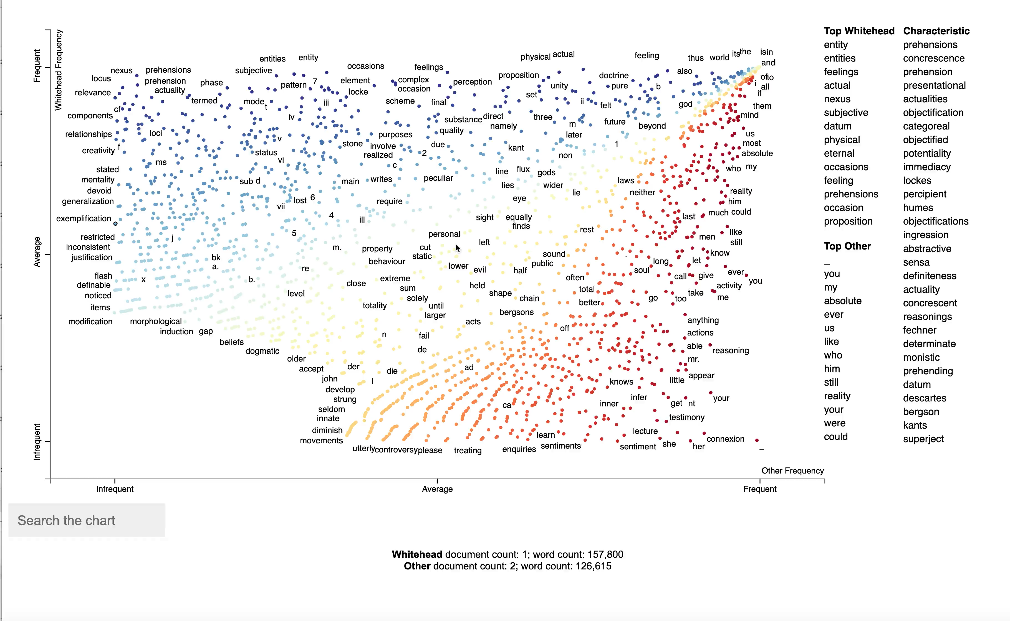
Scattertext of Whitehead vs. Hume and James
Jason Kessler

Slide 16
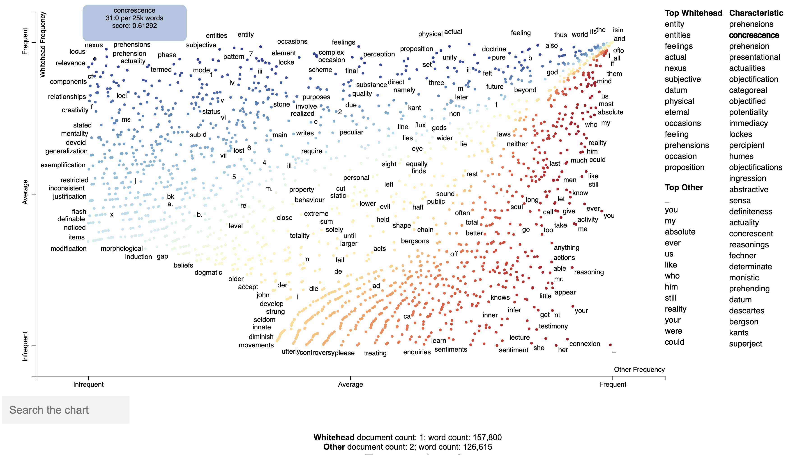
Scattertext of Whitehead vs. Hume and James
Jason Kessler

Slide 17
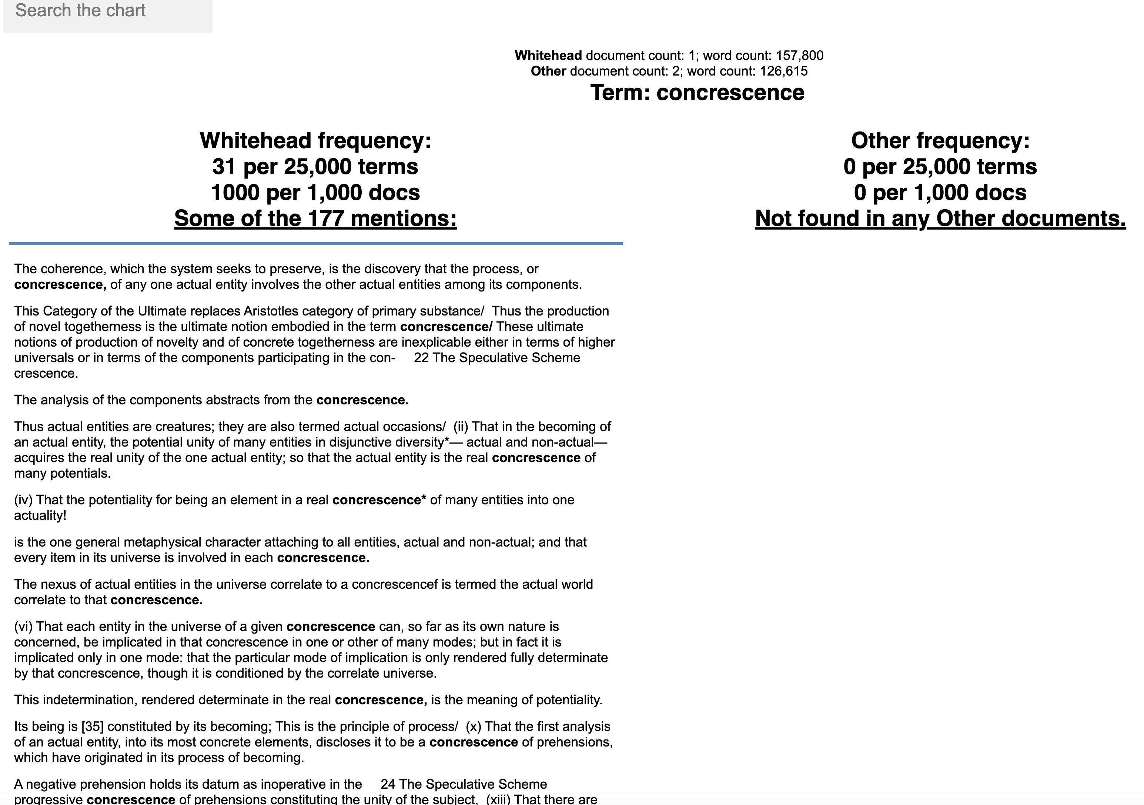
Jason Kessler

Slide 18
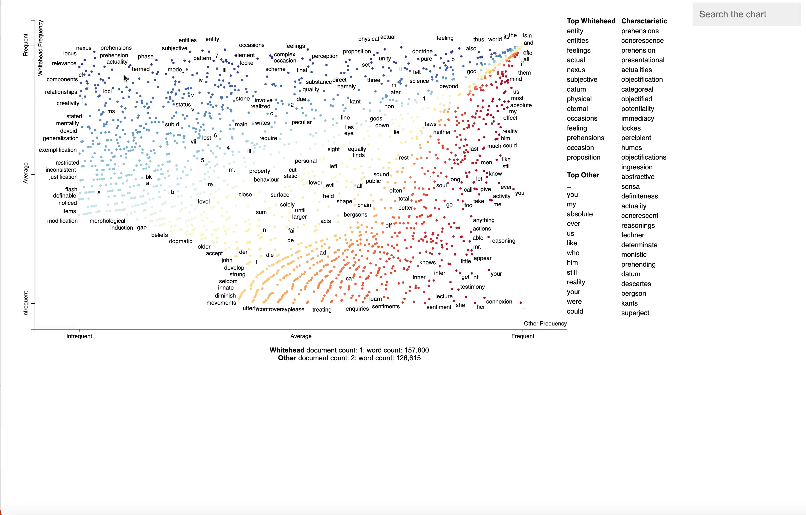

Slide 19
Beyond static representation
How is Whitehead’s verbal eccentricity distributed through his book?
Use this to navigate

Slide 20
TF-IDF
Term Frequency * Inverse Document Frequency
Term Count in document
Total documents
+1
*
log
Total Terms in document
Documents containing the term
+1

Slide 21
TF-IDF
Term Frequency * Inverse Document Frequency
TF
*
IDF
TF-IDF often used for document retrieval.
It’s been enhanced with hyperparameters for document length.
But document retrieval is not the present use case.

Slide 22
TF-IDF
Term Frequency * Inverse Document Frequency
TF
*
IDF
Alpha scaled TF-IDF
Amplifies the effect of rare words when a > 0
Equivalent to raw inverse document frequency when a = 1. (It ‘undoes’ the log.) Set a < 0 to dampen the effect of IDF.
(e
- IDF)
(IDF
+
IDF
a
TF
*
*
Common words are little affected by a

Slide 23
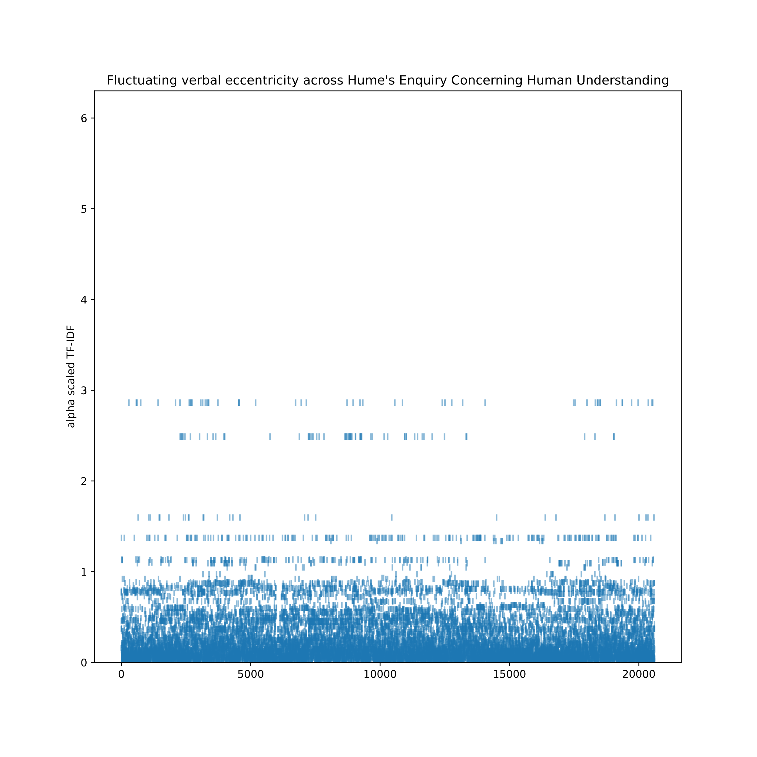
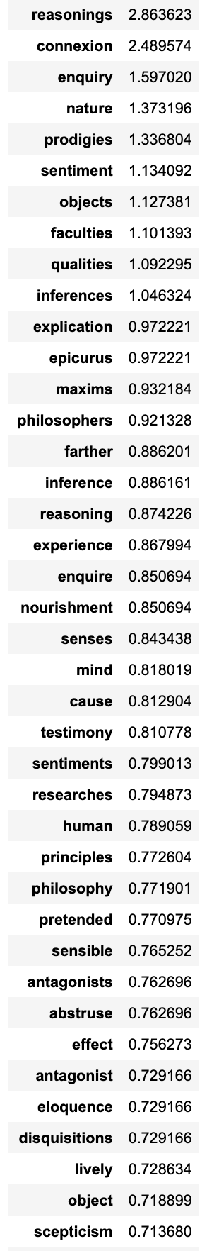
Hume
alpha scaled
TF-IDF
a = 0.0053
reasonings
connexion
enquiry
prodigies
nature
objects
sentiment
Every word from the start to the end of the book
11K documents from fetch20newsgroups corpus used for the outside documents to compute alpha scaled IDF

Slide 24
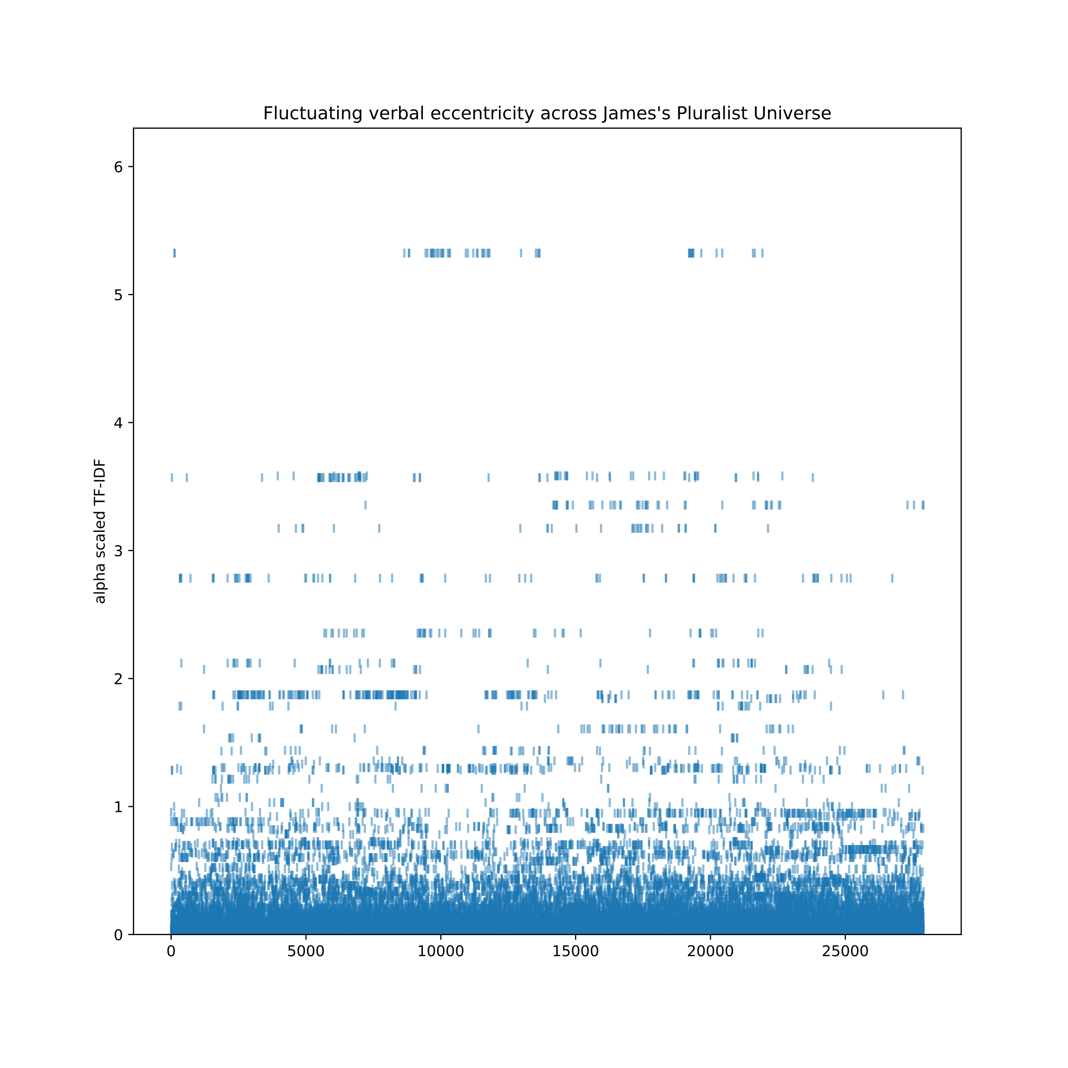
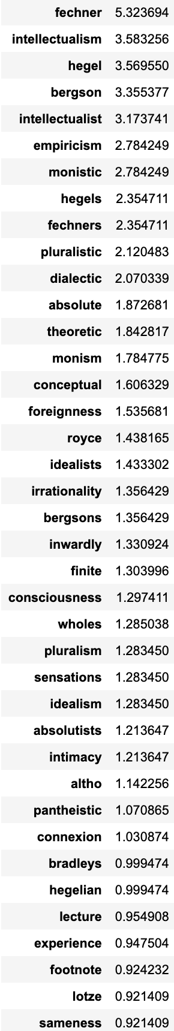
James
Fechner (proper name)
alpha scaled
TF-IDF
intellectualism
Hegel (proper name)
Bergson (proper name)
intellectualist
a = 0.0053
empiricism
Every word from the start to the end of the book
11K documents from fetch20newsgroups corpus used for the outside documents to compute adjusted scaled IDF

Slide 25
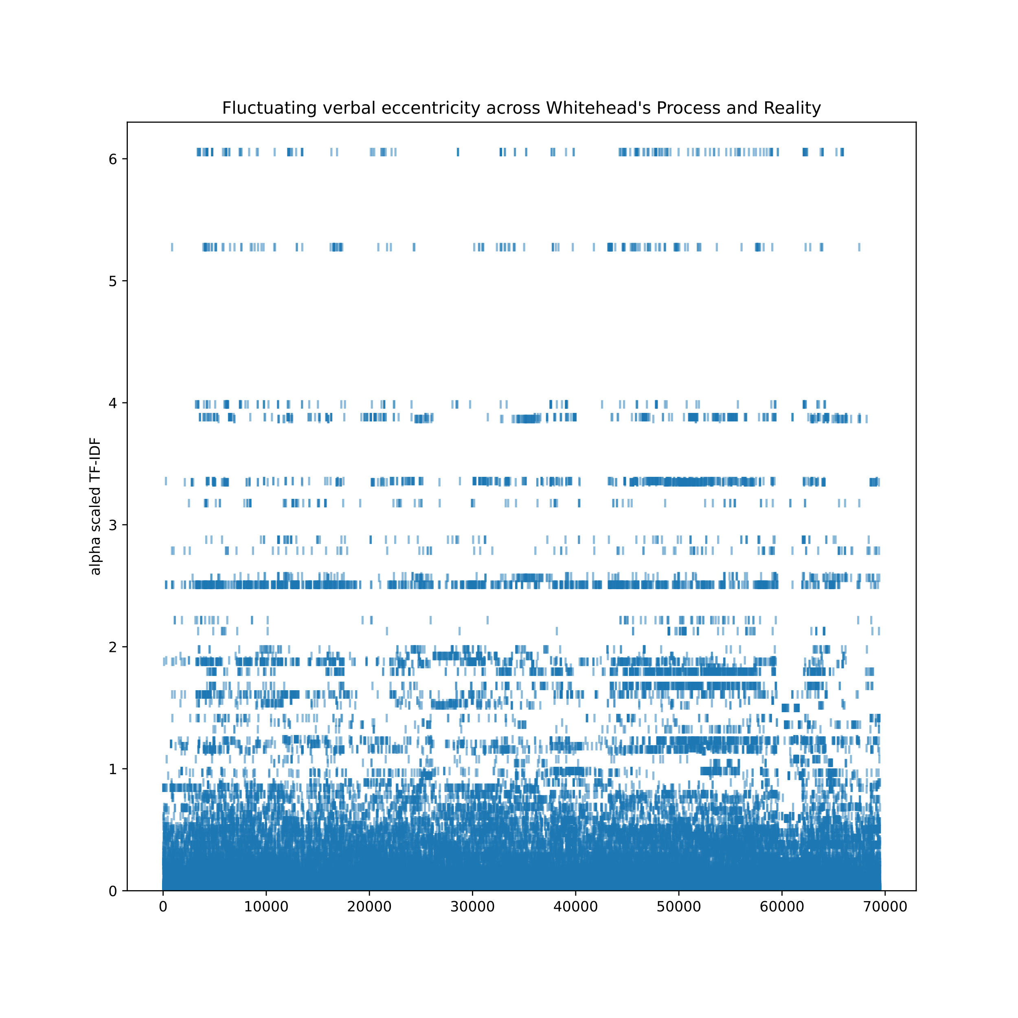
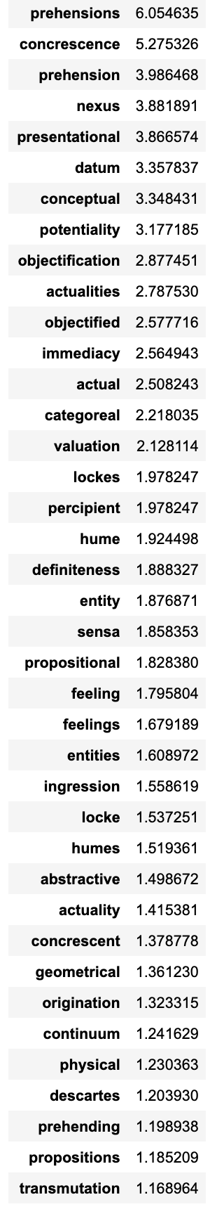
Whitehead
prehensions
concrescence
nexus
prehension
presentational
alpha scaled
TF-IDF
datum
conceptual
potentiality
a = 0.0053
Every word from the start to the end of the book
11K documents from fetch20newsgroups corpus used for the outside documents to compute adjusted alpha IDF

Slide 26
Comparing alpha scaled TF-IDF of all word instances in three philosophical texts
Hume
James
Whitehead

Slide 27
Whitehead
prehensions
concrescence
nexus
prehension
presentational
alpha scaled
TF-IDF
datum
conceptual
potentiality
a = 0.0053
Every word from the start to the end of the book
11K documents from fetch20newsgroups corpus used for the outside documents to compute adjusted alpha IDF

Slide 28
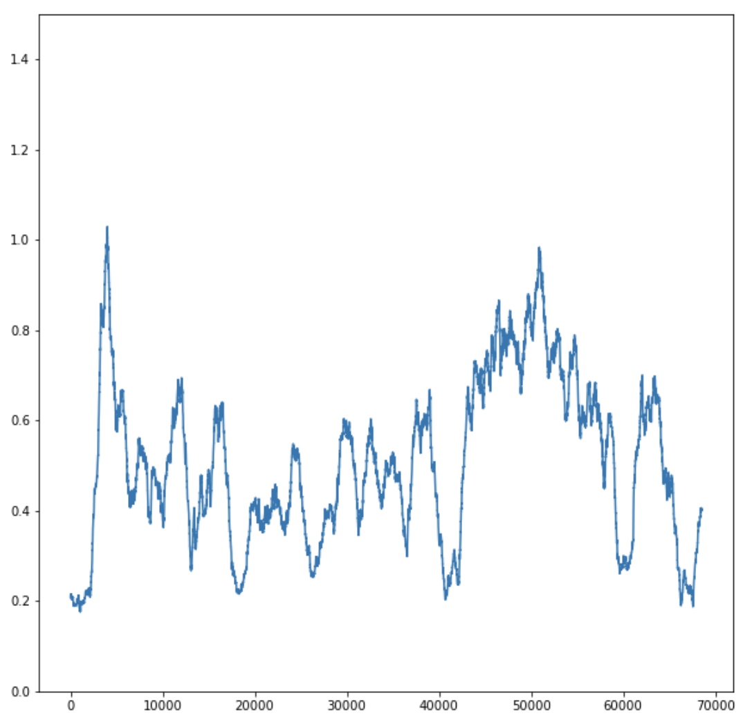
Whitehead
sliding window of 1000 words at a time
alpha adjusted
TF-IDF
alpha scaled
TF-IDF
a = 0.0053

Slide 29
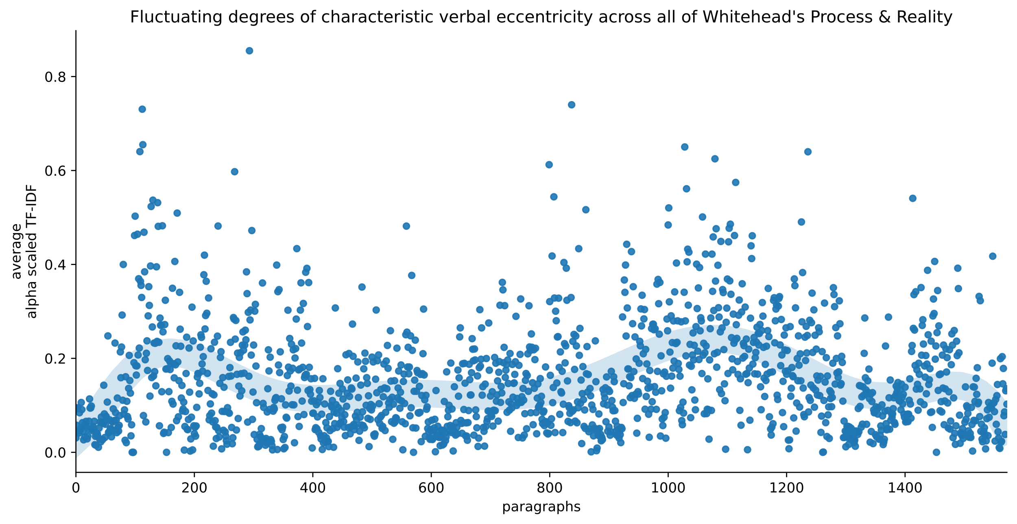
Prehensions of actual entities— i.e., prehensions whose data involve actual entities — are termed 'physical prehensions'; and prehensions of eternal objects are termed 'conceptual prehensions/ Consciousness is not necessarily involved in the subjective forms of either type of prehension.
Whitehead
A hybrid physical feeling originates for its subject a conceptual feeling with the same datum as that of the conceptual feeling of the antecedent subject. But the two conceptual feelings in the two subjects respectively may have different subjective forms.
every paragraph
alpha scaled
TF-IDF
a = 0.0053
scatterplot with a lowess curve

Slide 30
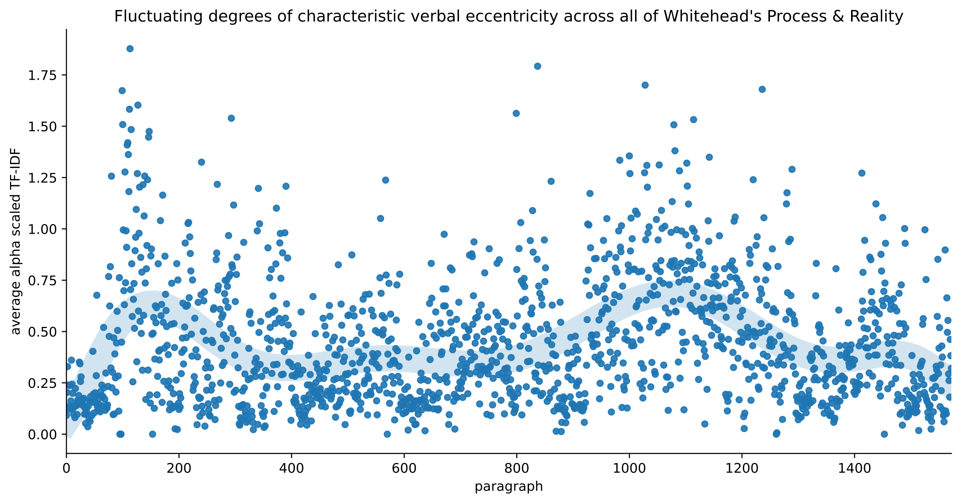
That the actual world is a process, and that the process is the becoming of actual entities. Thus actual entities are creatures; they are also termed 'actual occasions’
Whitehead
every paragraph
stopwords excluded
alpha scaled
TF-IDF
a = 0.0053
scatterplot with a lowess curve

Slide 31
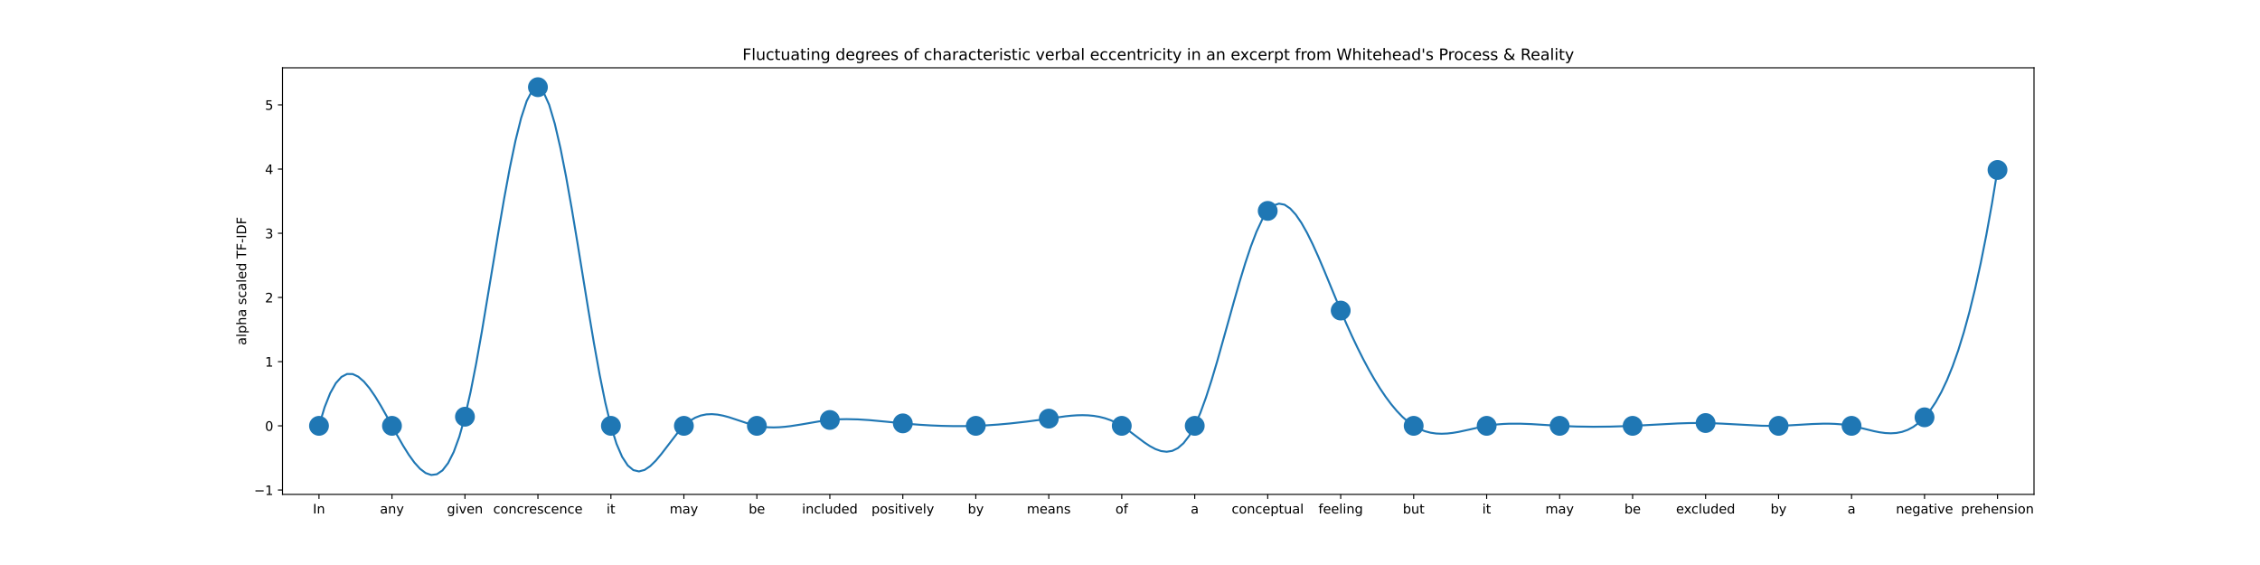

Possibilities for guiding inflected speech
based on flux of characteristic semantic-verbal eccentricity
scatterplot with b-spline as a visual guide

Slide 32

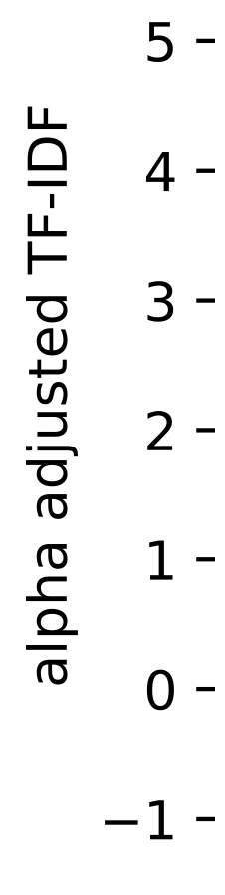

Slide 33
Applications
Recommender systems:
• Entice book readers and song listeners with book excerpts or song lyric excerpts, based on more specific criteria:
• Topically consistent passages
• Self-contained (self-explanatory) passages
• Verbally unusual, quirky, eccentric, idiosyncratic passages
Automated text-to-speech and algorithmic composition of songs
• Use fluctuating alpha scaled TF-IDF to inflect speech (or melody) based on unusual words prevalent in the document (lyrics)
Education
• New guided approach to navigate difficult, complex, idiosyncratic texts, based on locating (a) topically consistent passages, (b) self-standing (self-explanatory) passages, and ( c) idiosyncratic passages.

Slide 34
Further steps
Word2Vec
• Train word2vec separately on each book (each philosopher)
• Select words important to all (mind, concept, ontology) to compare philosophers
• Use word2vec wordmover to see what words are the same vector move away in each philosophers word vector space
• Compare the same words in each vector space for different ‘positives’ and ‘negatives’
• Analyze paragraph-to-paragraph topic-flow in terms of word2vec distance between consecutive paragraphs
CorEx
• Train CorEx separately on each of the book (each philosopher)
• Select words important to all (mind, concept, ontology) to compare philosophers
• Use these as anchor words and observe the same vs. different words created in the clustering of words in each book (each philosopher)
More books! More philosophers! More texts of other types!

Slide 35
New ways to read
‘Language on a holiday’
Machine learning applied to philosophical texts
Joshua Banks Mailman
jmailman@alumni.uchicago.edu

Slide 36
Appendix
An earlier version of alpha adjusted TF-IDF
Graphs generated using this earlier version

Slide 37
TF-IDF
Term Frequency * Inverse Document Frequency
TF
*
IDF
Alpha adjusted TF-IDF
amplifies the effect of rare words when a > 1
TF
(IDF–1)
TF
a
a
IDF
*
*
*
TF
Common words are little affected by a

Slide 38
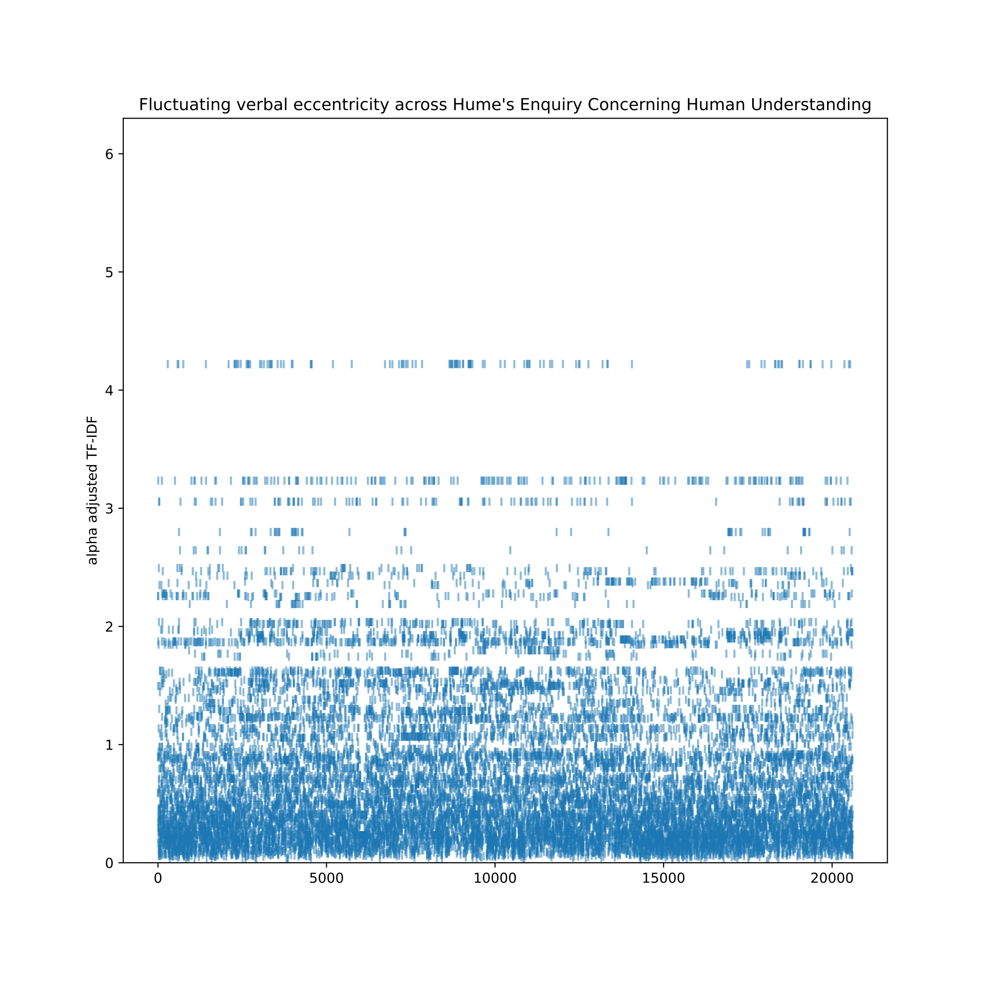
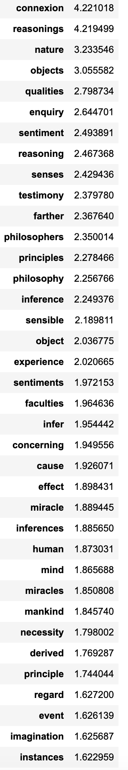
Hume
connexion
alpha adjusted
TF-IDF
reasonings
nature
qualities
enquiry
Every word from the start to the end of the book
11K documents from fetch20newsgroups corpus used for the outside documents to compute adjusted alpha IDF

Slide 39
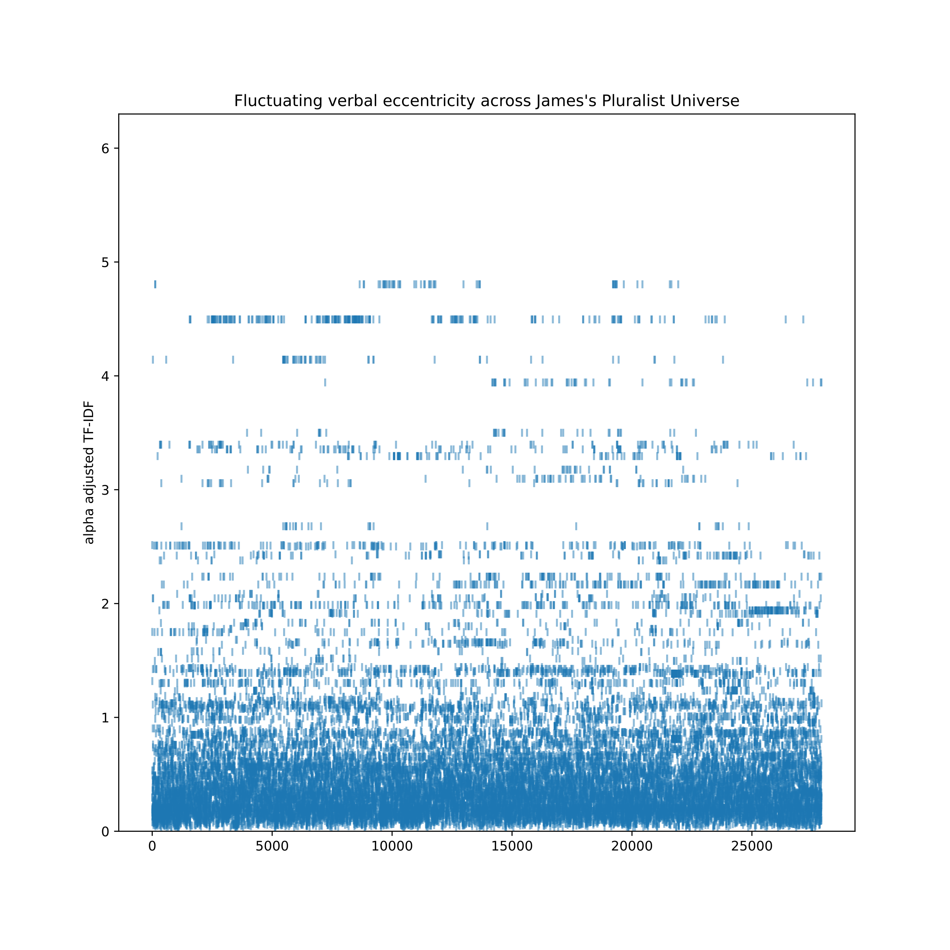
James
alpha adjusted
TF-IDF
Every word from the start to the end of the book
11K documents from fetch20newsgroups corpus used for the outside documents to compute adjusted alpha IDF

Slide 40
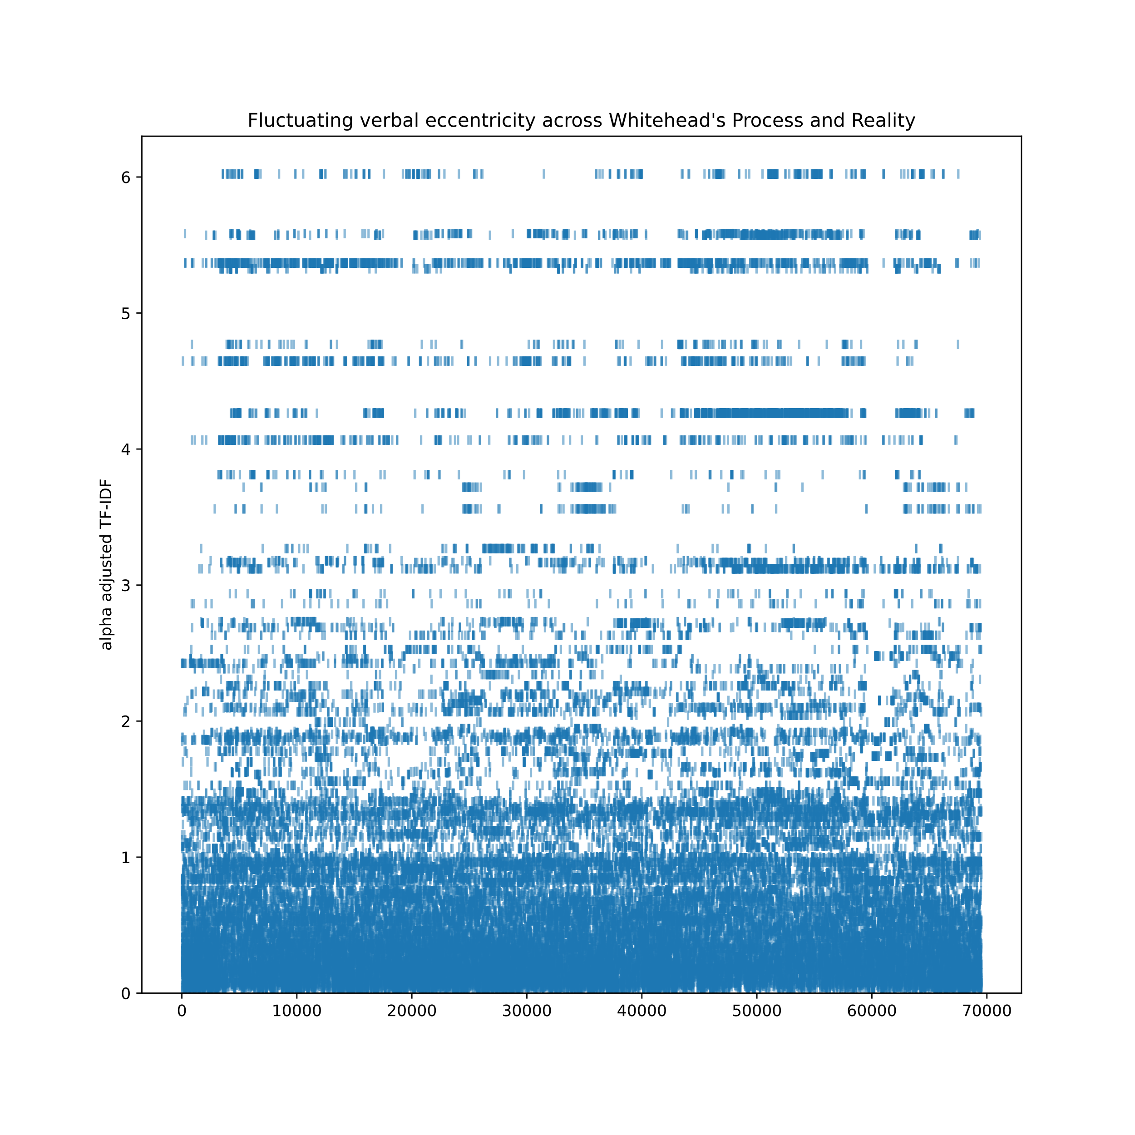
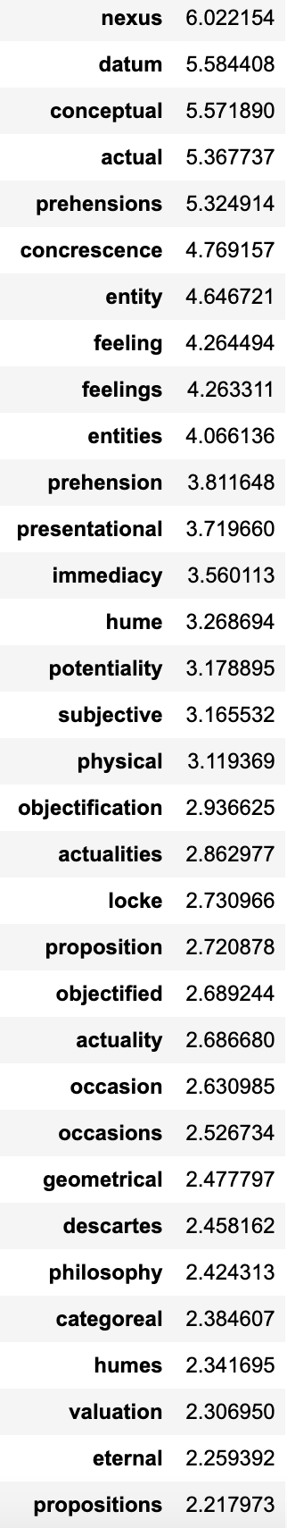
Whitehead
nexus
datum
conceptual
prehensions
actual
entity
concrescence
alpha adjusted
TF-IDF
Every word from the start to the end of the book
11K documents from fetch20newsgroups corpus used for the outside documents to compute adjusted alpha IDF

Slide 41
Comparing alpha adjusted TF-IDF of all word instances in three philosophical texts
Hume
James
Whitehead

Slide 42
Whitehead
alpha adjusted
TF-IDF
Every word from the start to the end of the book

Slide 43
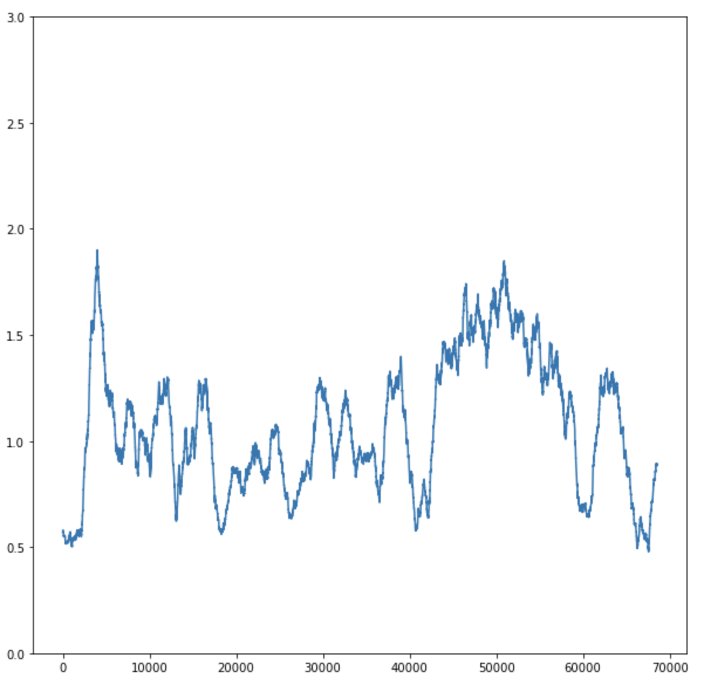
Whitehead
sliding window of 1000 words at a time
alpha adjusted
TF-IDF
alpha adjusted
TF-IDF

Slide 44
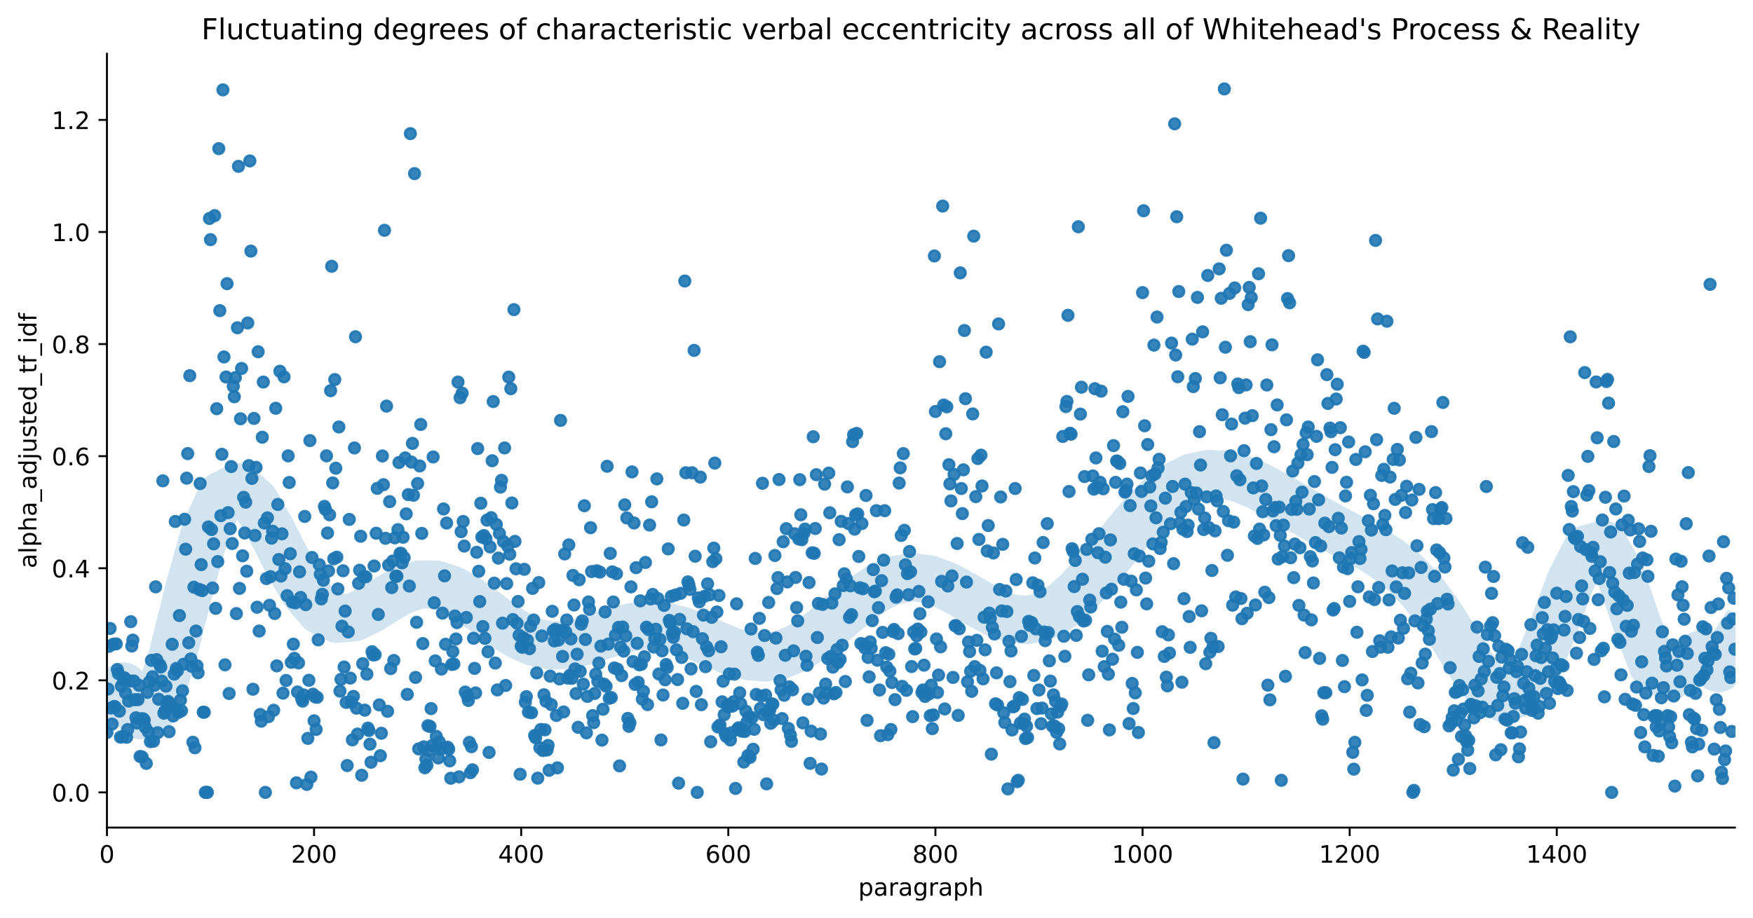
Prehensions of actual entities— i.e., prehensions whose data involve actual entities — are termed 'physical prehensions'; and prehensions of eternal objects are termed 'conceptual prehensions/ Consciousness is not necessarily involved in the subjective forms of either type of prehension.
Whitehead
A hybrid physical feeling originates for its subject a conceptual feeling with the same datum as that of the conceptual feeling of the antecedent subject. But the two conceptual feelings in the two subjects respectively may have different subjective forms.
every paragraph
alpha adjusted
TF-IDF
scatterplot with a lowess curve

Slide 45
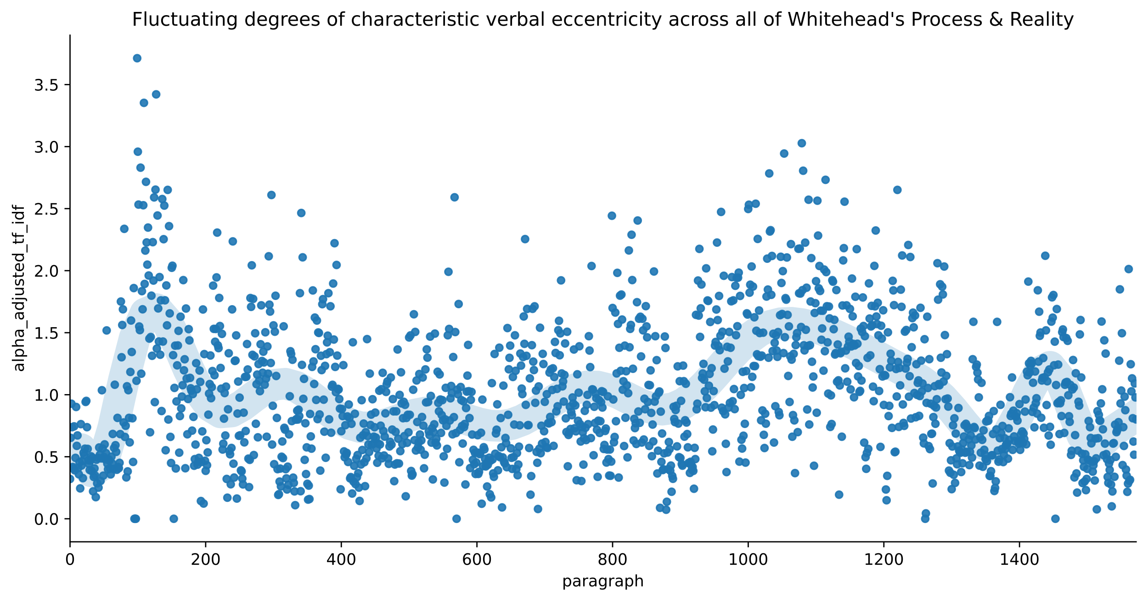
That the actual world is a process, and that the process is the becoming of actual entities. Thus actual entities are creatures; they are also termed 'actual occasions’
Whitehead
every paragraph
stopwords excluded
alpha adjusted
TF-IDF
scatterplot with a lowess curve

Slide 46
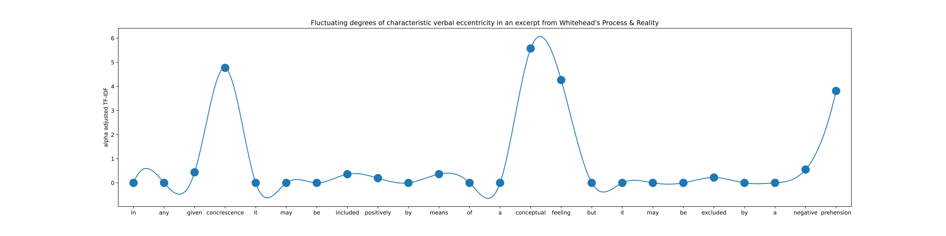
Possibilities for guiding inflected speech
based on flux of characteristic semantic-verbal eccentricity
scatterplot with b-spline as a visual guide

